Slide 1


Building and analyzing networks with Cytoscape and PSICQUIC

Slide 2
Workflow
Obtain protein-protein interactions
PSICQUIC-based interaction import client in Cytoscape
Visualize network
Cytoscape
Basic network analysis
Filtering your network based on columns
Cytoscape: Using filters
Integrate quantitative proteomics information in the network
Cytoscape: Load columns
Identify heavily connected sub-networks
Cytoscape: clusterMaker2 app
Analyze meaningful GO annotation
Cytoscape: BiNGO app

Slide 3
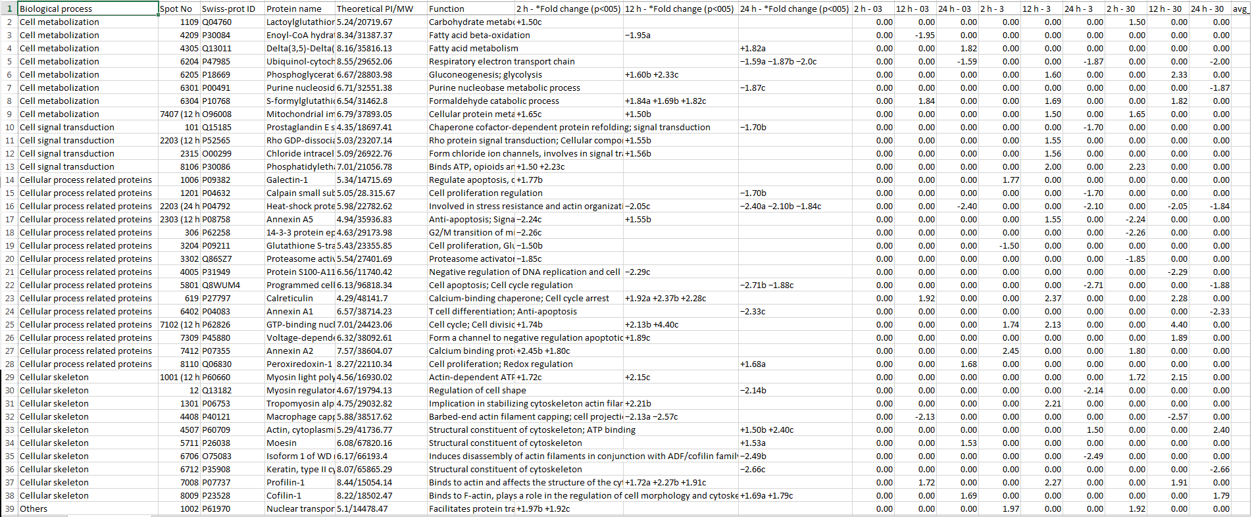
Our dataset: columns table
Table2_formatted.xlsx

Slide 4
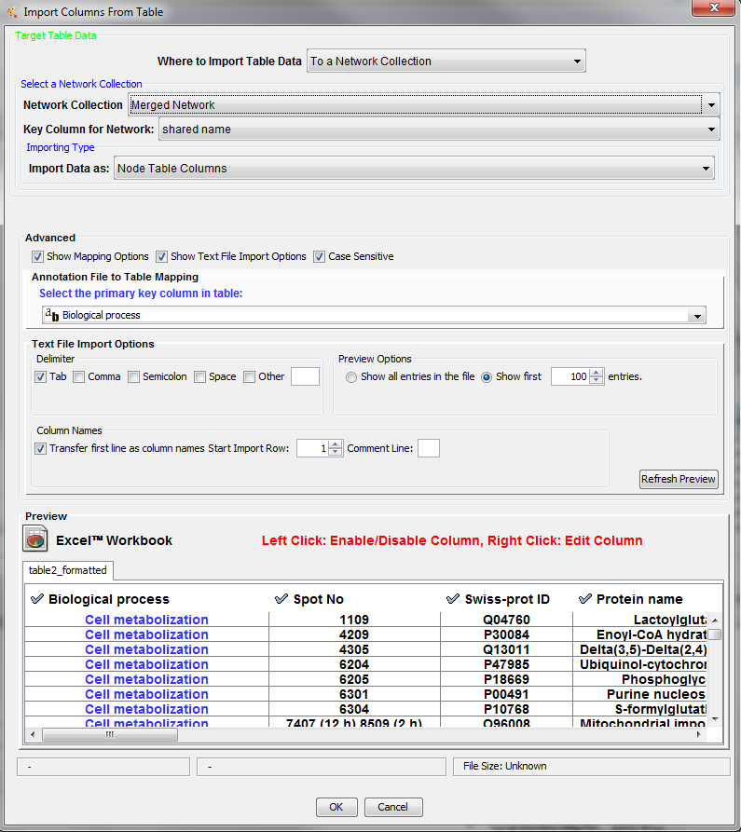
Importing columns to Cytoscape
File → Import → Table → File…

Slide 5

Try to create a sub-network to see how the proteins that are over-represented after 12 hours of treatment with 30 µg/ml of MWCNTs are connected.
Make use of filters and the ‘Create new networks for selected nodes, all edges’ function.
Try first picking only those protein for which you can find values and then try again creating a network including their 1st-level interacting partners.

Slide 6
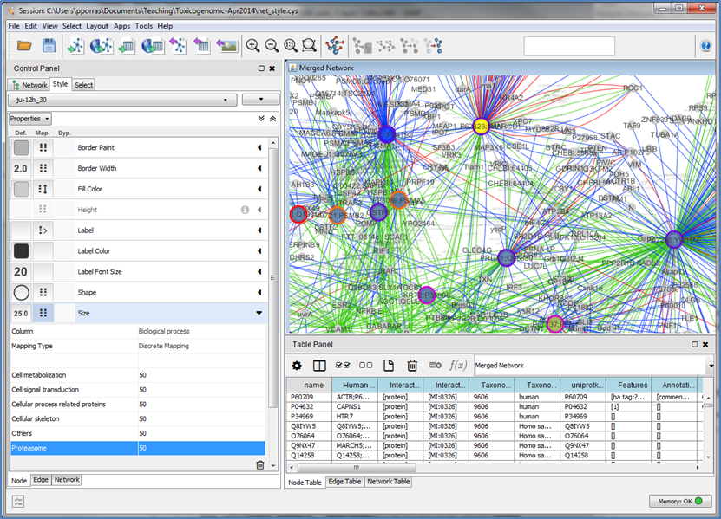
Using Styles

Slide 7
Try creating a new network in which you represent the relative quantification of the proteins affected by the exposure to 30 µg/ml of MWCNTs after 24 hours.

Slide 8
Workflow
Obtain protein-protein interactions
PSICQUIC-based interaction import client in Cytoscape
Visualize network
Cytoscape
Basic network analysis
Filtering your network based on columns
Cytoscape: Using filters
Integrate quantitative proteomics information in the network
Cytoscape: Load columns
Identify heavily connected sub-networks
Cytoscape: clusterMaker2 app
Analyze meaningful GO annotation
Cytoscape: BiNGO app

Slide 9
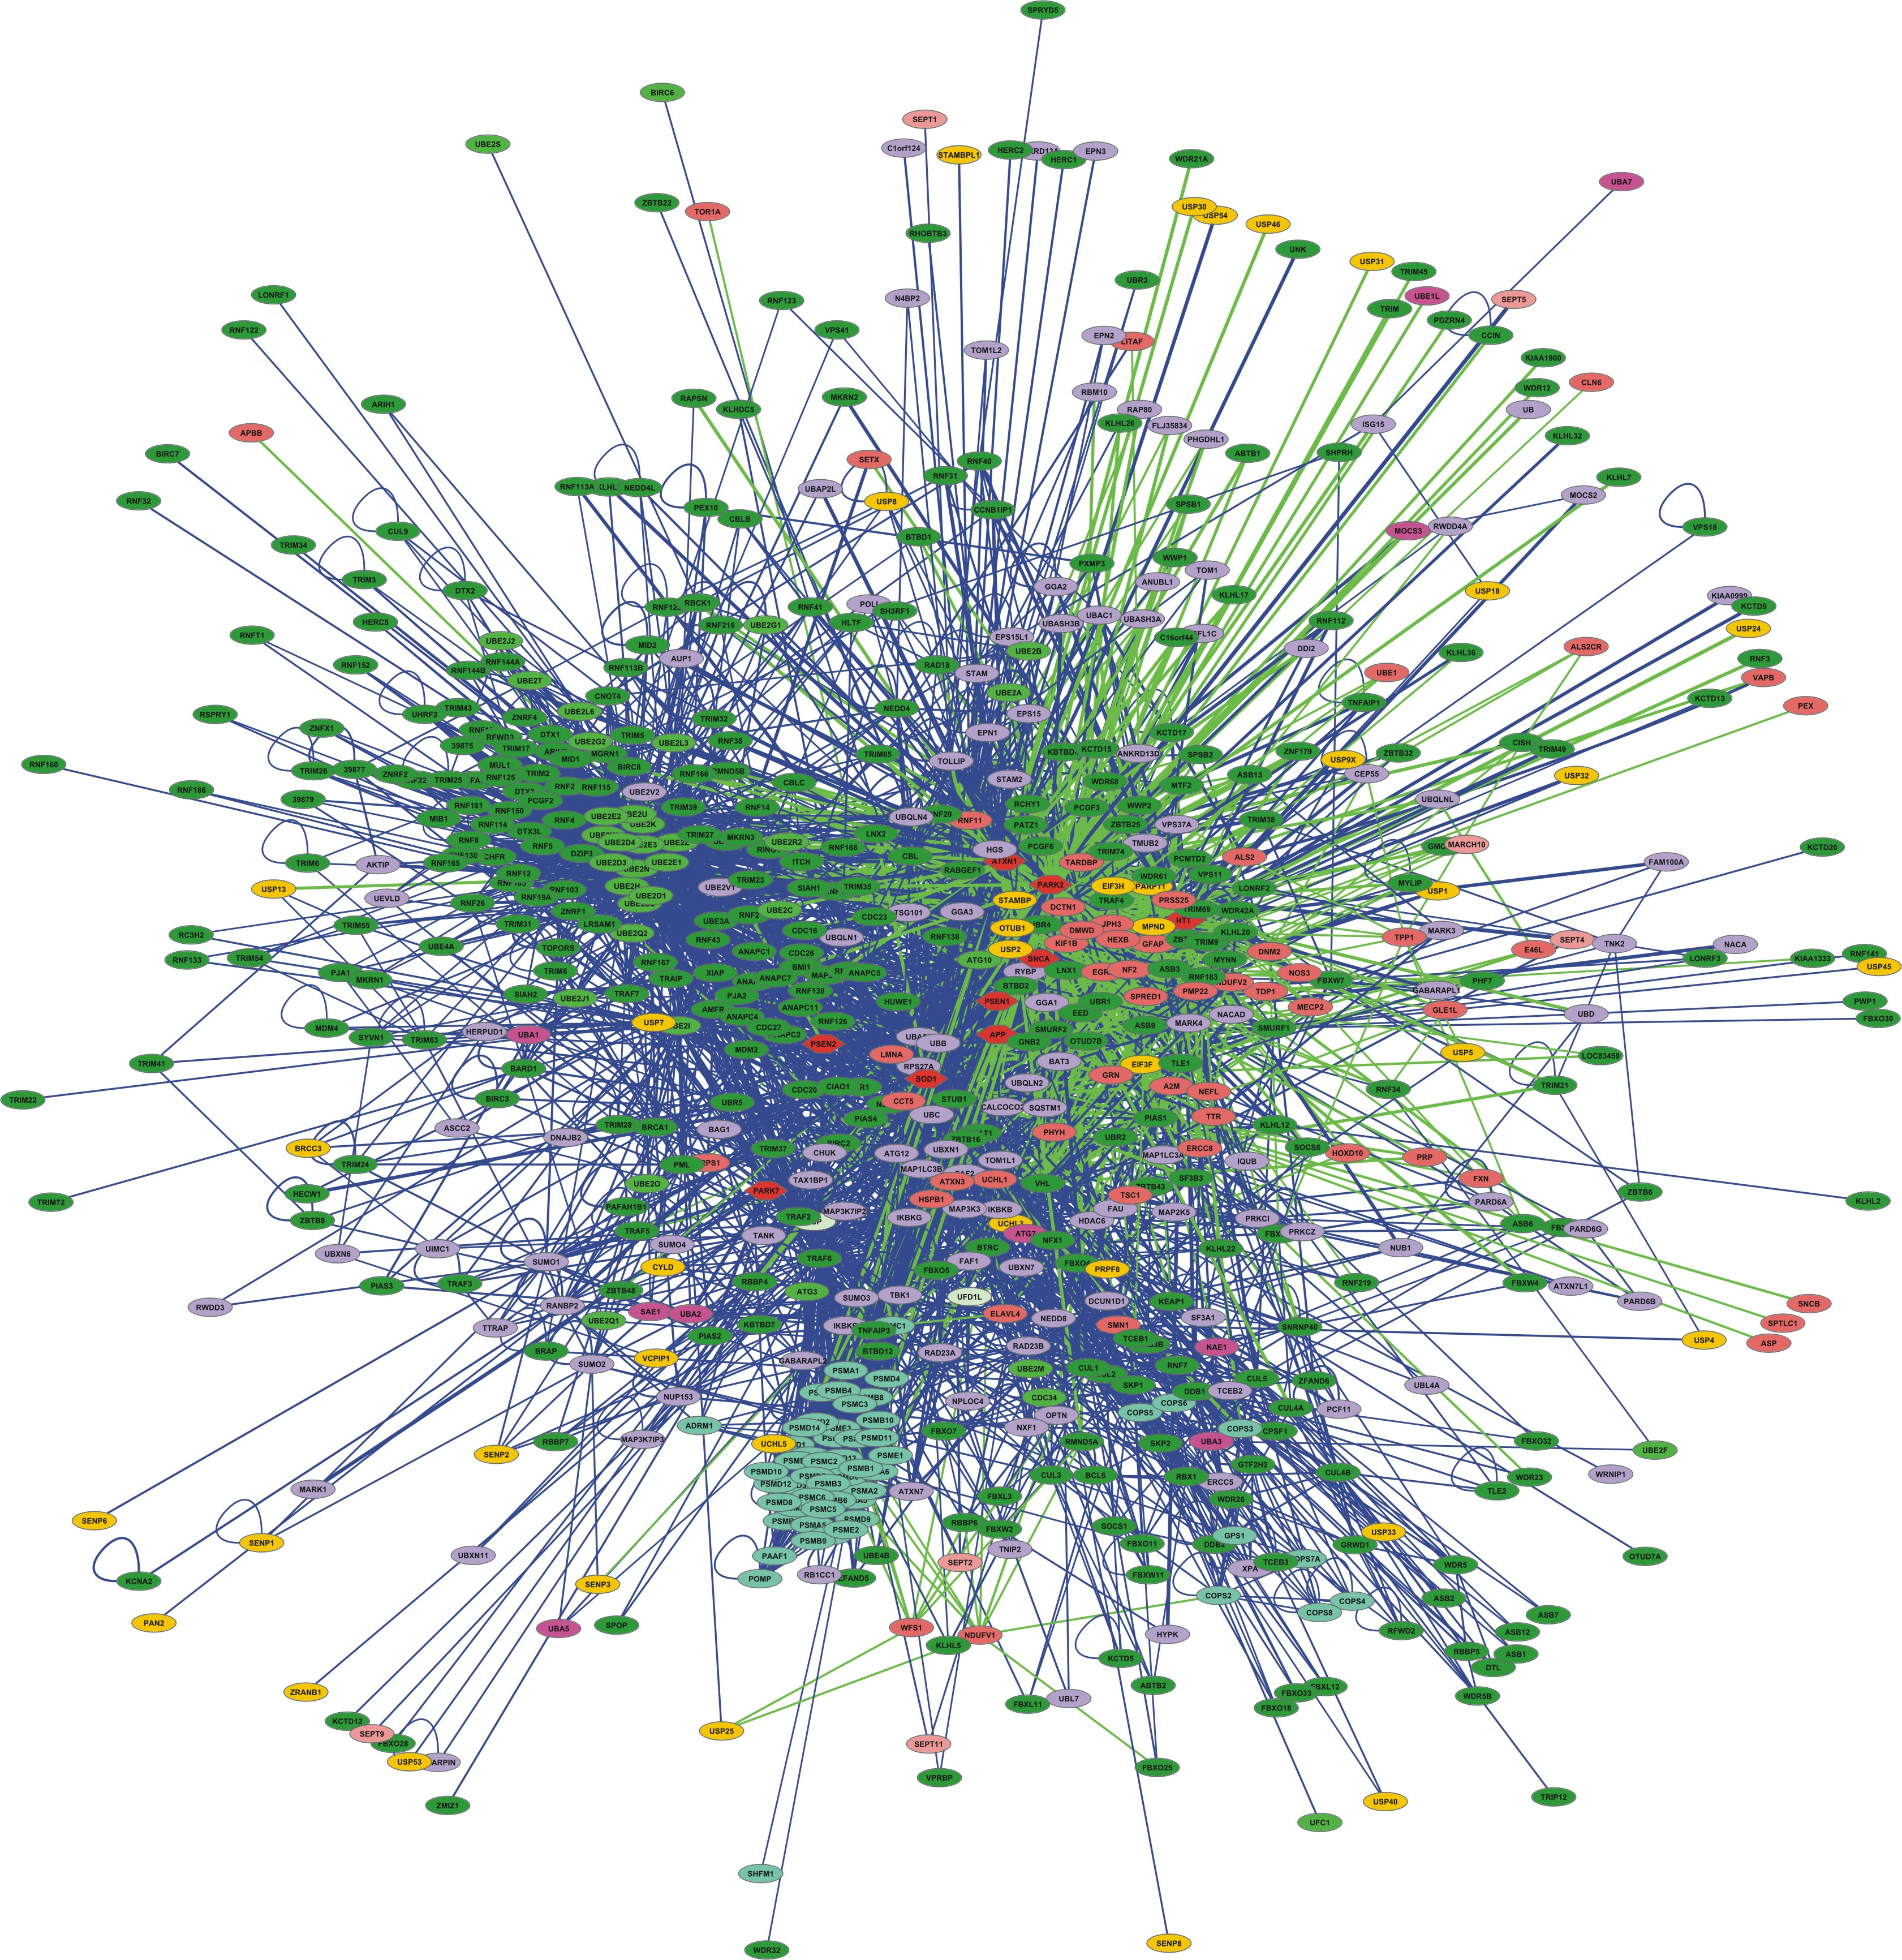
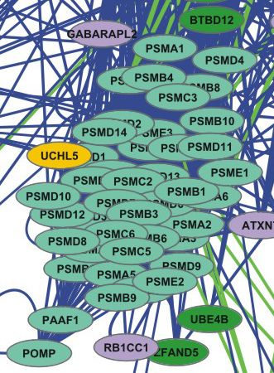
Topological clusters
Transitivity/ Clustering - A network shows clustering if the probability of pair of nodes being adjacent is higher when the two nodes have a common neighbor.
Functions are likely to be carried out in a highly modular manner.
High clustering => High modularity
Ubiquitin-proteasome system network
Proteasome cluster
Notes:
NOT SO SURE ABOUT THIS ONE, CHECK WITH SANDRA

Slide 10
Network topological analysis: clustering methods
Glay community clustering
Implementation of the Newman-Girvan fast greedy algorithm.
The algorithm identifies clusters by iteratively removing edges from the network and then checking to see which nodes are still connected.
MCODE
Finds highly interconnected regions in a network. The algorithm uses a three-stage process:
Weighting: gives a higher score to those nodes whose neighbours are more interconnected.
Molecular complex prediction: starting with the highest-weighted node (seed), recursively move out, adding nodes to the complex that are above a given threshold.
Post-processing, which applies filters to improve the cluster quality (haircut and fluff).
Check http://www.youtube.com/watch?v=7wA4ZEoFGl8 and http://www.cgl.ucsf.edu/cytoscape/cluster/clusterMaker.html#mcode.

Slide 11
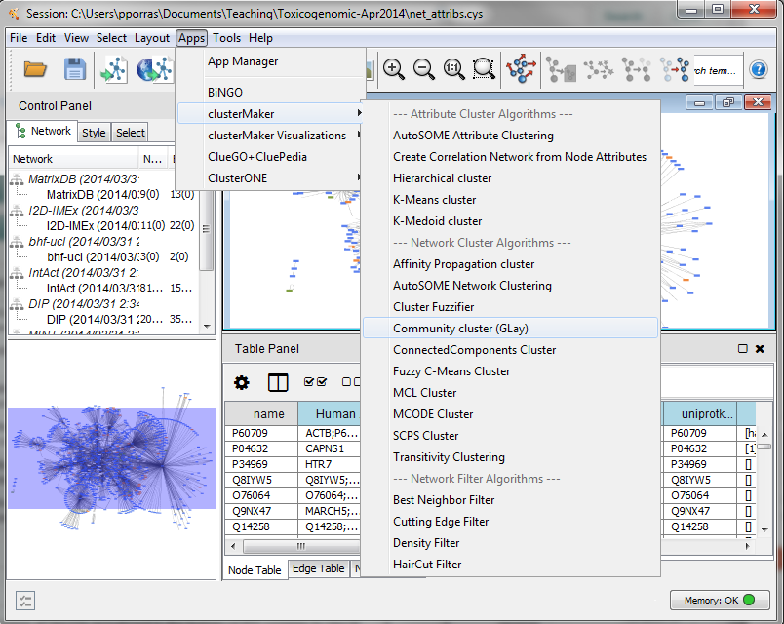
clusterMaker: selecting the algorithm
Apps → clusterMaker → Community cluster (GLay)
Notes:
We are now going to work with the main large cluster and ignore the orphan interactions around the periphery.
If you have installed clusterMaker, then in the Plugins menu, there will be an option called “Cluster”. We are going to use a clustering algorithm called “Community Cluster”.
Select the central large
Go to Plugins → Cluster → Community cluster (GLay).

Slide 12
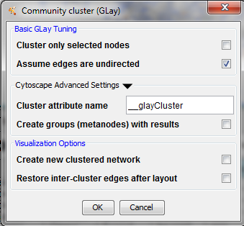
clusterMaker2: creating the clusters
Notes:
A window will now appear, presenting the options for Community Cluster. We are going to accept the default options. Click the “Create Clusters” button.

Slide 13
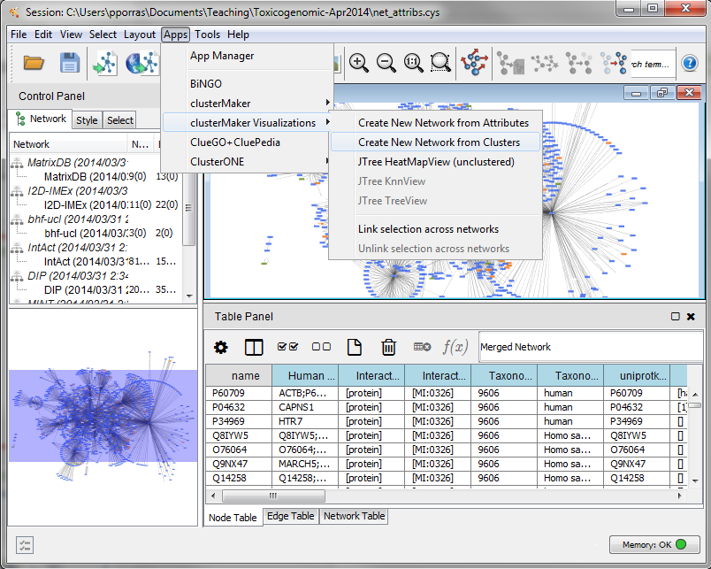
clusterMaker2: visualizing the clusters
Apps → clusterMaker Visualizations→ Create New network from Clusters
Notes:
When Community Cluster is finished, it reports to us what it has found. Note that unlike some other clustering algorithms, we don’t have to tell Community Cluster how many clusters to find. Instead Community Cluster will report to use how many clusters it thinks there are.

Slide 14
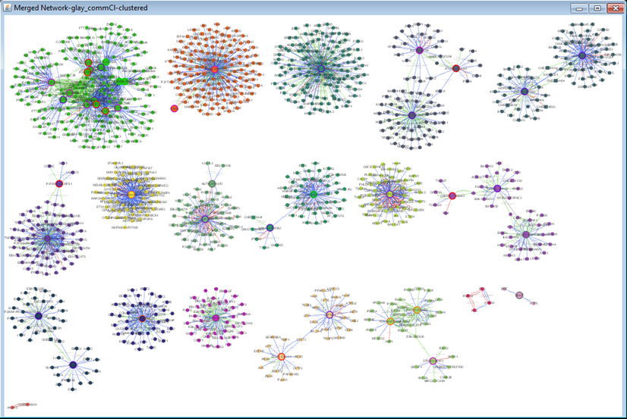
clusterMaker2: visualizing the clusters
Notes:
The Visualize Clusters button was previously grayed out. Now the clusters have been identified, the “Visualize Clusters” button is active. Click it to display the clusters the algorithm has found.

Slide 15
Try to repeat the clustering search using MCODE this time.
What is the main difference to Glay?
Try different values for the advanced parameters in MCODE and see how that affects your results.

Slide 16
Workflow
Obtain protein-protein interactions
PSICQUIC-based interaction import client in Cytoscape
Visualize network
Cytoscape
Basic network analysis
Filtering your network based on columns
Cytoscape: Using filters
Integrate quantitative proteomics information in the network
Cytoscape: Load columns
Identify heavily connected sub-networks
Cytoscape: clusterMaker2 app
Analyze meaningful GO annotation
Cytoscape: BiNGO app

Slide 17
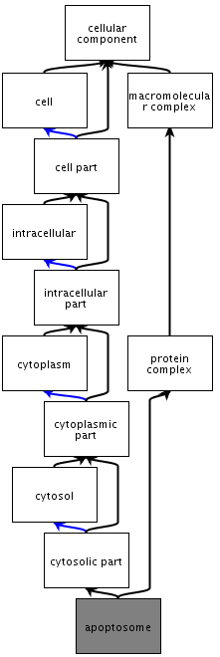
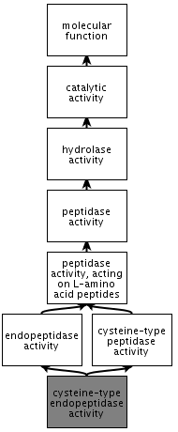
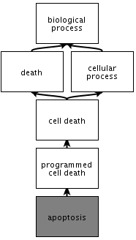
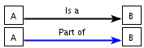
Gene ontology
http://geneontology.org/
What is the gene ontology?
Organized, controlled vocabulary of terms that describe gene products characteristics.
Example:
GO terms for Caspase 9

Slide 18
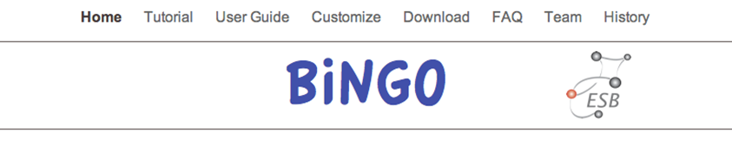
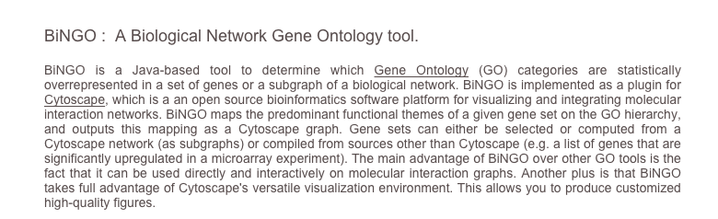
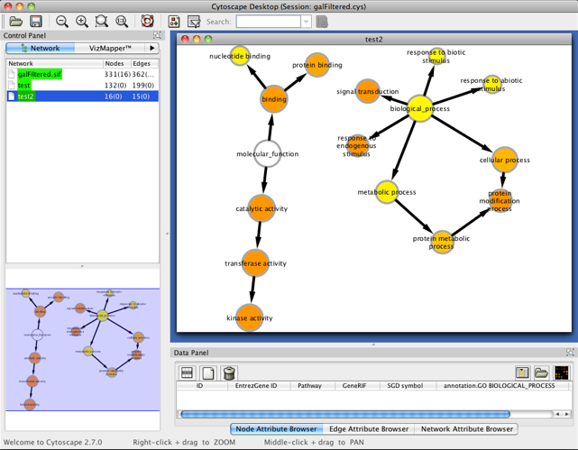
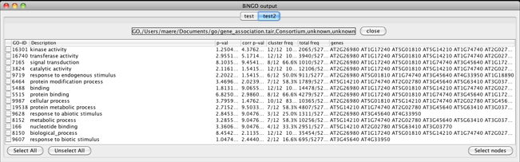
Gene ontology enrichment analysis

Slide 19
Gene ontology enrichment analysis
BiNGO performs a hypergeometric test to find out which functional categories are over- or under-represented in our dataset and which proteins are annotated with such categories, giving a table of results as an output. The test can be referenced to the whole ontology or to the network itself.
Additionally, BiNGO draws the over-represented categories as a Cytoscape graph, in which the relationships between different terms is depicted.
BiNGO can be used with lists of genes/proteins, whole networks or network sub-sections, making it easy to combine with other Cytoscape functionalities.

Slide 20
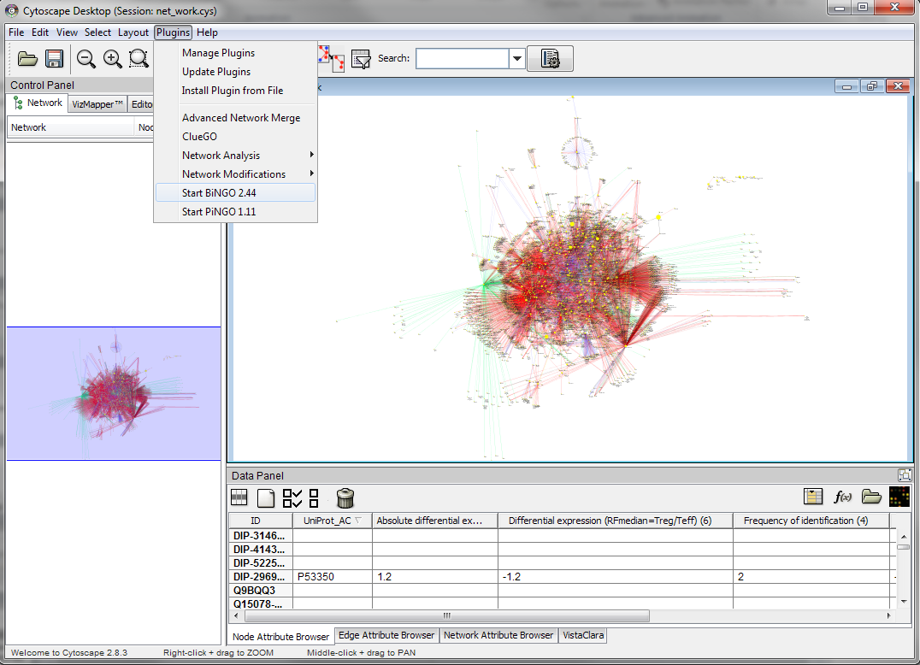
Gene ontology enrichment analysis
Apps → BiNGO

Slide 21
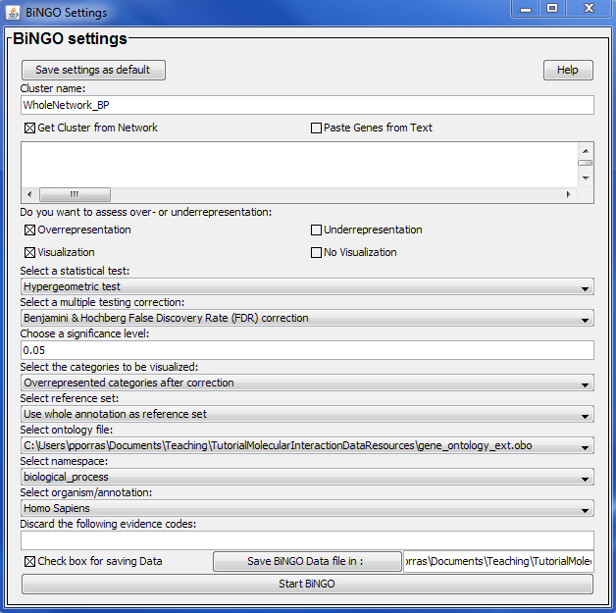
Gene ontology enrichment analysis
1
2
3
4

Slide 22
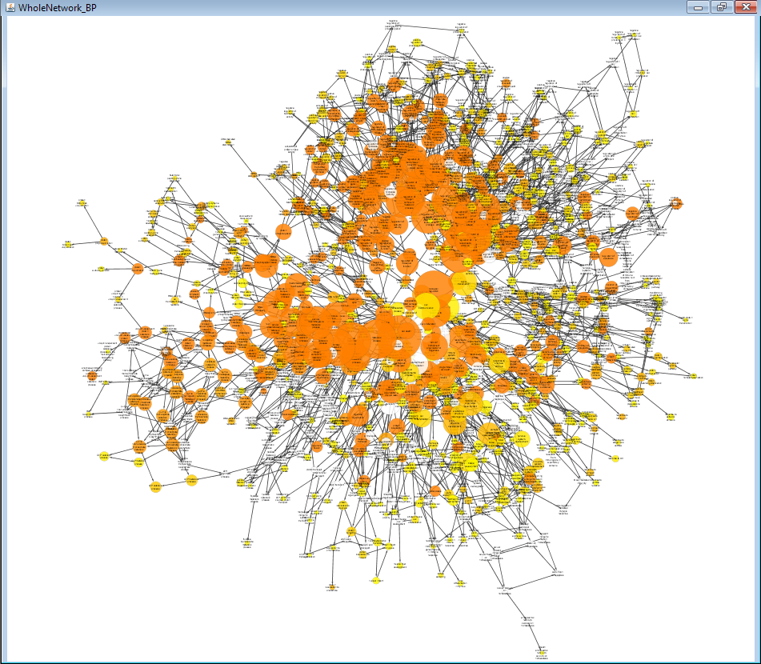
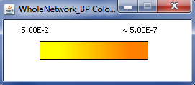
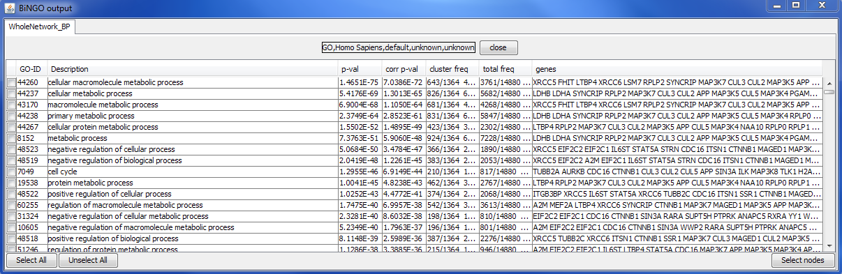
Gene ontology enrichment analysis

Slide 23
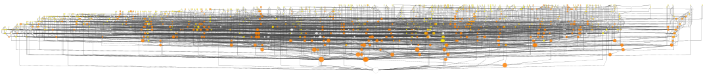
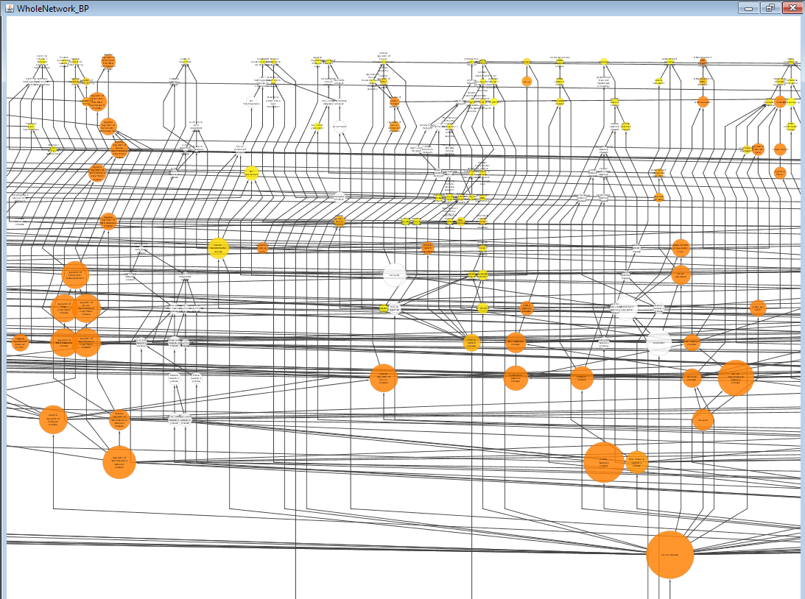
Gene ontology enrichment analysis
Choose Layouts → Cytoscape Layouts → Hierarchical layout
Child terms
negative regulation of transcription from RNA polymerase II promoter
granularity
regulation of macromolecule metabolic process
Parent terms

Slide 24
Final test
The output of the analysis as we have performed it is terribly complicated. Try to repeat it using the generic GOSlim ontology that is provided in the file ‘goslim_generic.obo’.
How does the analysis look like now?
Which processes are specifically over-represented in those proteins over-represented proteins in cells exposed to 30 µg/mL of MWCNTs in the 12 hours time point?
Repeat the BiNGO analysis and find out which processes are involving proteins connected to over-represented proteins in cells exposed to 30 µg/mL of MWCNTs in the 12 hours time point.
What is the difference between the results of these two analysis?
Combine the ontology enrichment and the cluster analysis to try to figure out the functionality behind the different topological clusters found by clusterMaker2. Check for clusters where over/under-represented proteins are especially prominent to find functional modules potentially different cells exposed to different doses of MWCNTs at different time points.

Slide 25


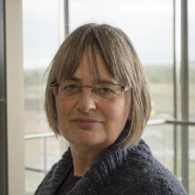
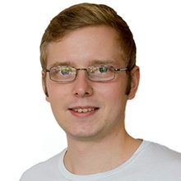
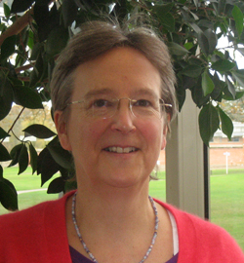
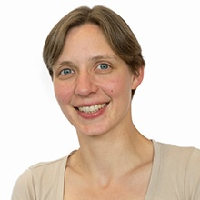
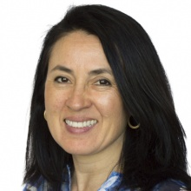
Acknowledgements
MI Team leader
Developing team
Sandra Orchard
Max Koch
Curation team
All files accessible at
www.ebi.ac.uk/~pporras/teaching_materials/network_analysis_liv_2015.zip
Margaret Duesbury
Birgit Meldal
Mariaestela Ortiz

